Slide 1
Chapter 9 Phase-Locked Loops
9.1 Basic Concepts
9.2 Type-I PLLs
9.3 Type-II PLLs
9.4 PFD/CP Nonidealities
9.5 Phase Noise in PLLs
9.6 Loop Bandwidth
9.7 Design Procedure
9.8 Appendix I: Phase Margin of Type-II
PLLs
Behzad Razavi, RF Microelectronics.
Prepared by Bo Wen, UCLA

Slide 2
Chapter Outline
Type-I PLLs
Type-II PLLs
PLL Nonidealities
VCO Phase Alignment
Dynamics of Type-I PLLs
Frequency Multiplication
Drawbacks of Type-I PLL
Phase/Frequency Detectors
Charge Pump
Charge-Pump PLLs
Transient Response
PFD/CP Nonidealities
Circuit Techniques
VCO Phase Noise
Reference Phase Noise

Slide 3
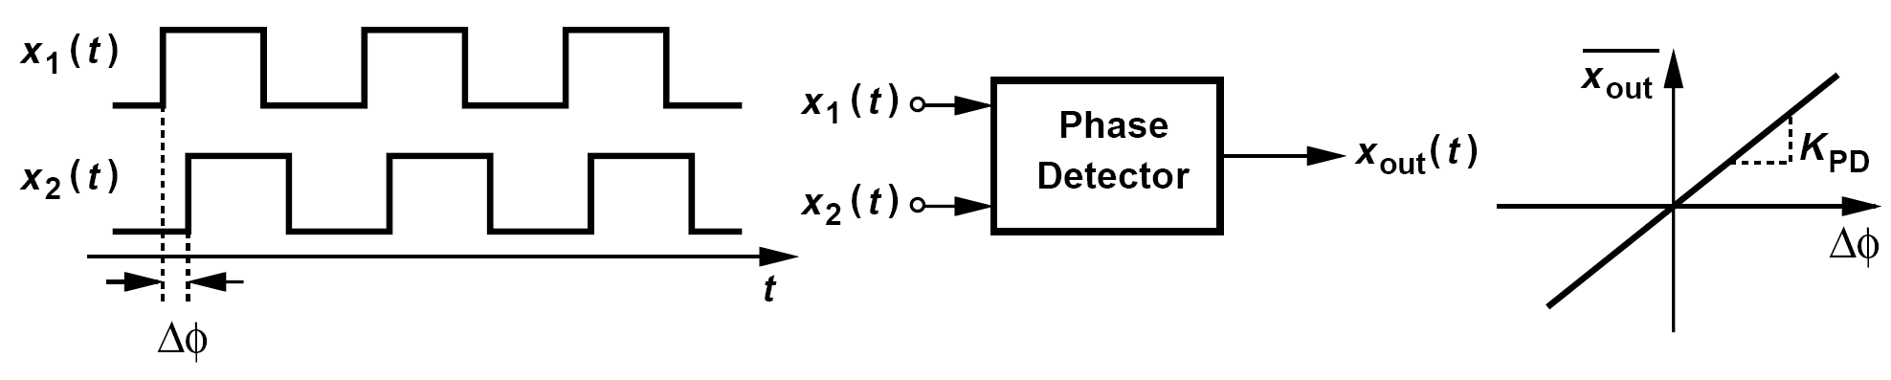
Phase Detector
A PD is a circuit that senses two periodic inputs and produces an output whose average value is proportional to the difference between the phases of the inputs
The input/output characteristic of the PD is ideally a straight line, with a slope called the “gain” and denoted by K_{PD}

Slide 4
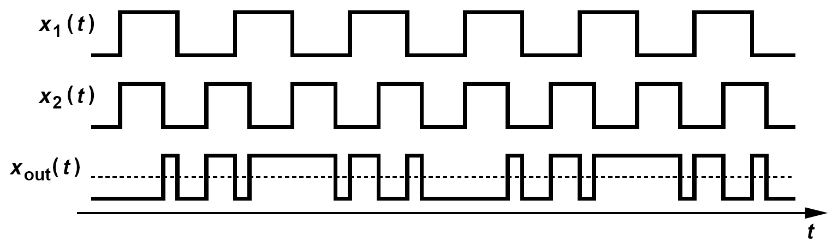
Example of Phase Detector
Must the two periodic inputs to a PD have equal frequencies?
Solution:
They need not, but with unequal frequencies, the phase difference between the inputs varies with time. Figure above depicts an example, where the input with a higher frequency, x₂(t), accumulates phase faster than x₁(t), thereby changing the phase difference, ΔΦ. The PD output pulsewidth continues to increase until ΔΦ crosses 180 °, after which it decreases toward zero. That is, the output waveform displays a “beat” behavior having a frequency equal to the difference between the input frequencies. Also, note that the average phase difference is zero, and so is the average output.

Slide 5
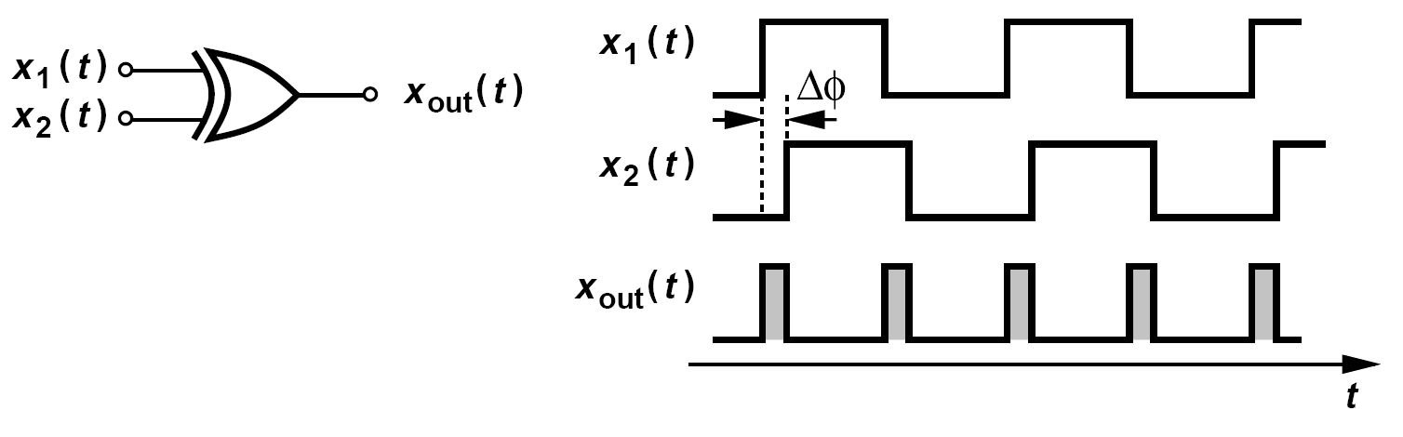
How is the PD Implemented?
We seek a circuit whose average output is proportional to the input phase difference.
An Exclusive-OR (XOR) gate can serve this purpose. It generates pulses whose width is equal to Δϕ

Slide 6
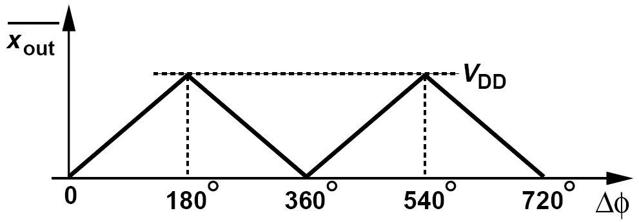
Example of XOR PD (Ⅰ)
Plot the input/output characteristic of the XOR PD for two cases: (a) the circuit has a single-ended output that swings between 0 and V_{DD}, (b) the circuit has a differential output that swings between -V₀ and +V₀.
Solution:
(a) Assigning a swing of V_{DD} to the output pulses shown in previous figure, we observe that the output average begins from zero for ΔΦ= 0 and rises toward V_{DD} as ΔΦ approaches 180° (because the overlap between the input pulses approaches zero). As ΔΦ exceeds 180°, the output average falls, reaching zero at ΔΦ = 360°. Figure above depicts the behavior, revealing a periodic, nonmonotonic characteristic.

Slide 7
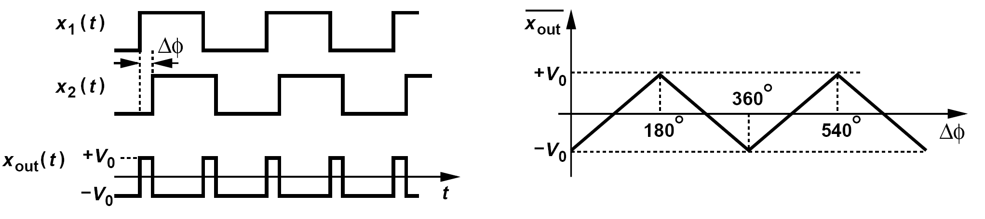
Example of XOR PD (Ⅱ)
Plot the input/output characteristic of the XOR PD for two cases: (a) the circuit has a single-ended output that swings between 0 and V_{DD}, (b) the circuit has a differential output that swings between -V₀ and +V₀.
Solution:
(b) Plotted in figure above for a small phase difference, the output exhibits narrow pulses above -V₀ and hence an average nearly equal to -V₀. As ΔΦ increases, the output spends more time at +V₀, displaying an average of zero for ΔΦ = 90°. The average continues to increase as ΔΦ increases and reaches a maximum of +V₀ at ΔΦ = 180°. As shown top right, the average falls thereafter, crossing zero at ΔΦ = 270° and reaching -V₀ at 360°.

Slide 8
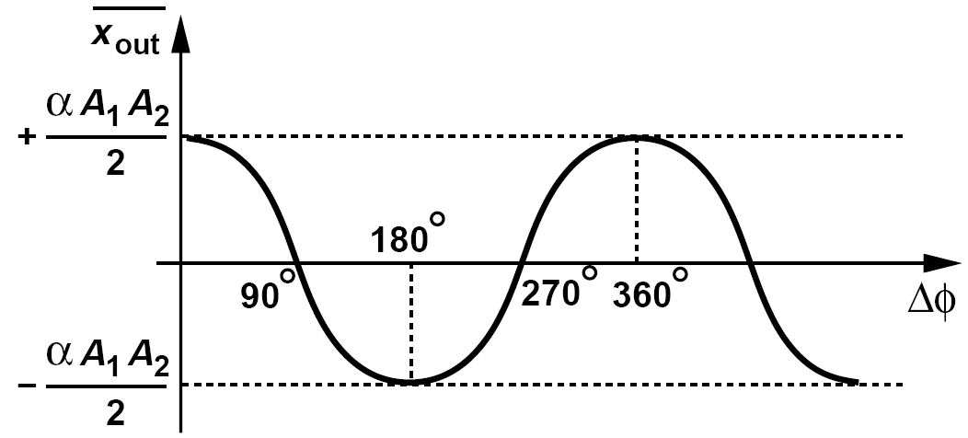
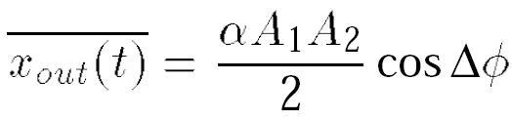
Example of a MOS Switch as a PD
A single MOS switch can operate as a “poor man’s phase detector”. Explain how.
Solution:
A MOS switch can serve as a return-to-zero or a sampling mixer. For two signals x₁(t) = A₁cos ω₁t and x₂(t) = A₂ cos(ω₂t + Φ), the mixer generates
if ω₁ = ω₂, then the average output is given by
This characteristic resembles a “smoothed” version of that of the previous example. The gain of this PD varies with ΔΦ, reaching a maximum of ± αA₁A₂/2 at odd multiples of π/2.

Slide 9
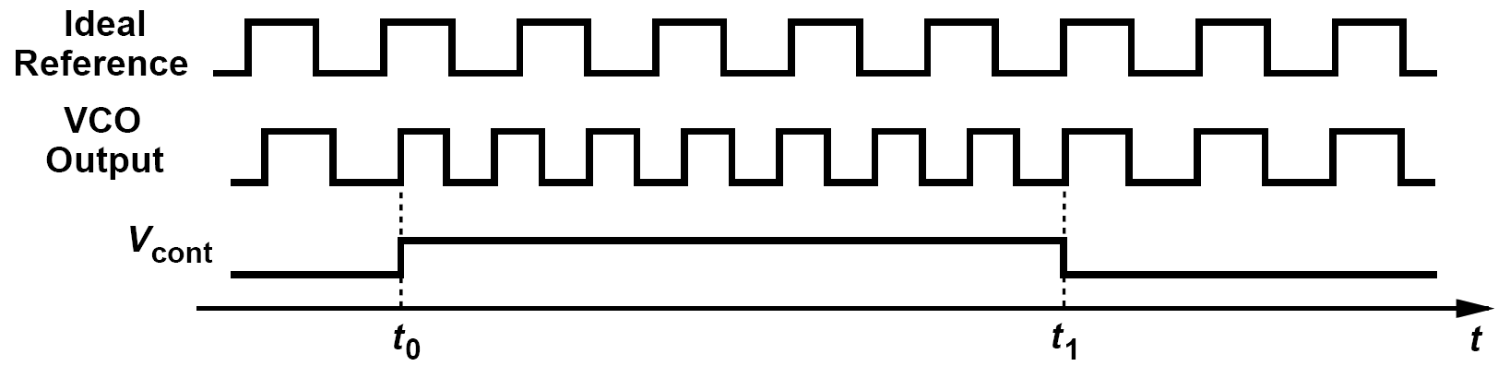
Type-I PLLs: Alignment of a VCO’s Phase
To null the finite phase error, we must:
(1)change the frequency of the VCO
(2)allow the VCO to accumulate phase faster(or more slowly) than the
reference so that the phase error vanishes
(3)change the frequency back to its initial value

Slide 10
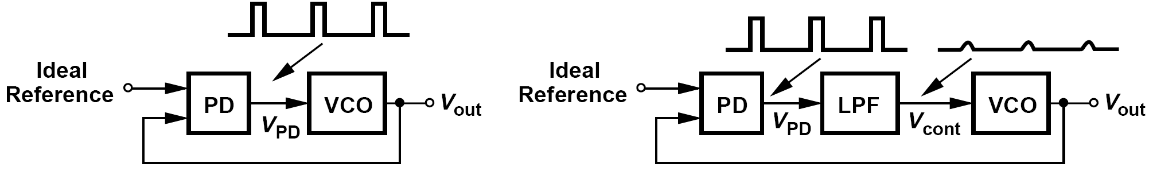
Simple PLL and Loop Filter
Negative feedback loop: if the “loop gain” is sufficiently high, the circuit minimizes the input error.
The PD produces repetitive pulses at its output, modulating the VCO frequency and generating large sidebands.
Interpose a low-pass filter between the PD and the VCO to suppress these pulses.
A student reasons that the negative feedback loop must force the phase error to zero, in which case the PD generates no pulses and the VCO is not disturbed. Thus, a low-pass filter is not necessary.
As explained later, this feedback system suffers from a finite loop gain, exhibiting a finite phase error in the steady state. Even PLLs having an infinite loop gain contain nonidealities that disturb V_{cont}

Slide 11
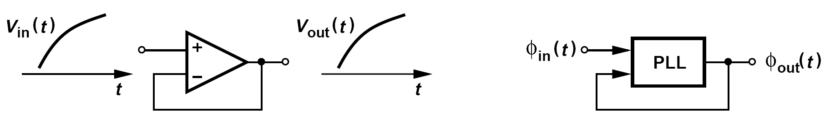

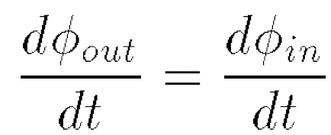
Simple PLL: Phase Locking
We say the loop is “locked” if ϕ_{out}(t)-ϕ_{in}(t) is constant with time.
An important and unique consequence of phase locking is that the input and output frequencies of the PLL are exactly equal.

Slide 12
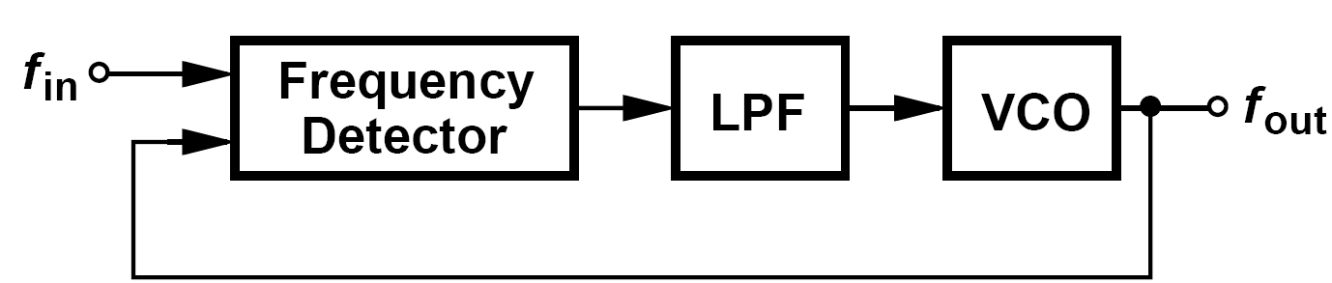
Example of Replacing the PD with a Frequency Detector
A student argues that the input and output frequencies are exactly equal even if the phase detector in the previous simple PLL with low-pass filter is replaced with a “frequency detector” (FD), i.e., a circuit that generates a dc value in proportion to the input frequency difference. Explain the flaw in this argument.
Solution:
As figure above depicts the student’s idea. We may call this a “frequency-locked loop” (FLL). The negative feedback loop attempts to minimize the error between f_{in} and f_{out}. But, does this error fall to zero? This circuit is analogous to the unity-gain buffer, whose input and output may not be exactly equal due to the finite gain and offset of the op amp. The FLL may also suffer from a finite error if its loop gain is finite or if the frequency detector exhibits offsets.

Slide 13
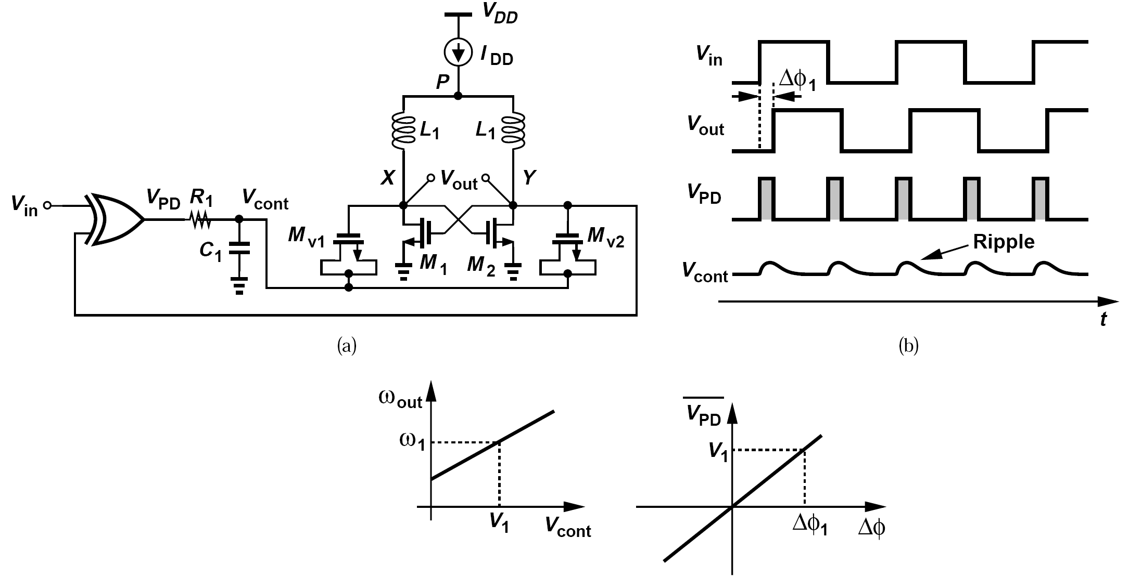
Analysis of Simple PLLs
If the loop is locked, the input and output frequencies are equal, the PD generates repetitive pulses, the loop filter extracts the average level , and the VCO senses this level so as to operate at required frequency

Slide 14
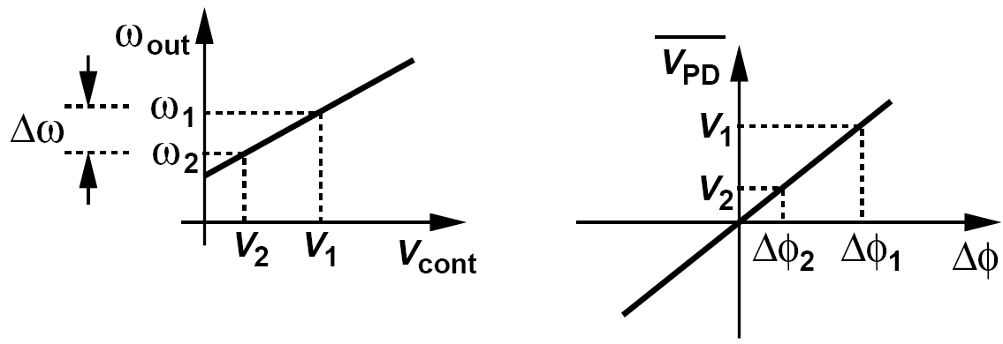
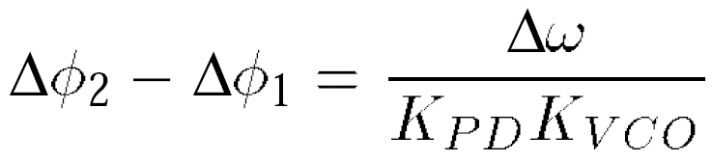
Example of Phase Error
If the input frequency changes by Δω, how much is the change in the phase error? Assume the loop remains locked.
Solution:
Depicted in figure above, such a change requires that V_{cont} change by Δω/K_{VCO}. This in turn necessitates a phase error change of
The key observation here is that the phase error varies with the frequency. To minimize this variation, K_{PD}K_{VCO} must be maximized. This quantity is sometimes called the “loop gain” even though it is not dimensionless.

Slide 15
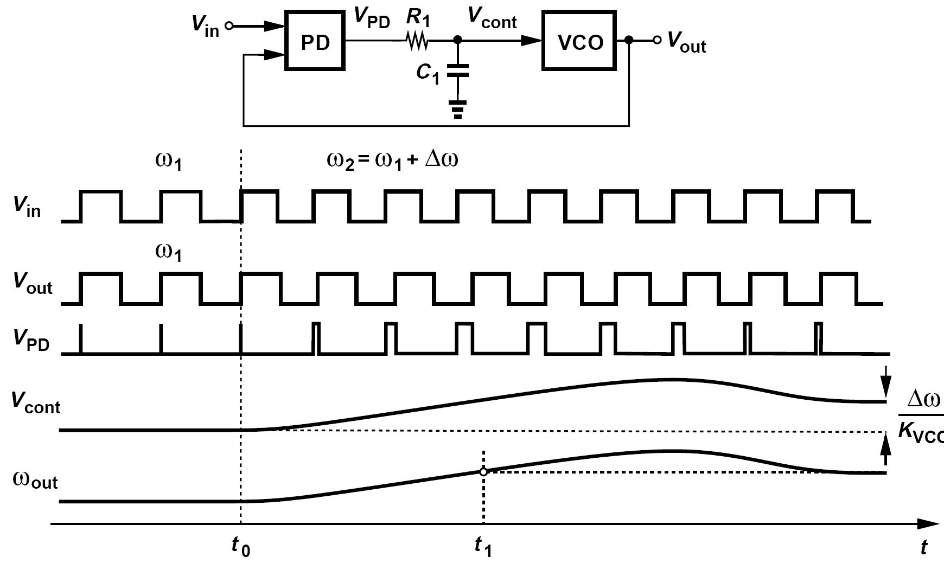
Response of PLL to Input Frequency Step
The loop locks only after two conditions are satisfied:
(1)ω_{out} becomes equal to ω_{in}
(2)the difference between ϕ_{in} and ϕ_{out} settles to its proper value

Slide 16
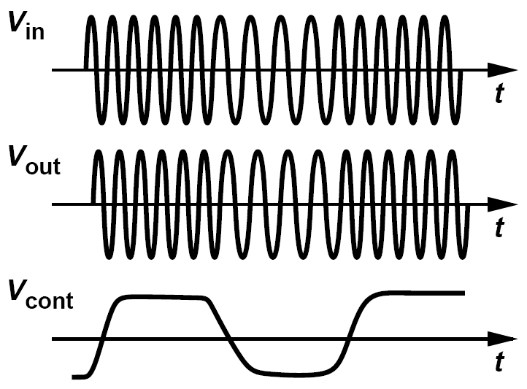
Example of FSK Input Applied to PLL
An FSK waveform is applied to a PLL. Sketch the control voltage as a function of time.
Solution:
The input frequency toggles between two values and so does the output frequency. The control voltage must also toggle between two values. The control voltage waveform therefore appears as shown in figure above, providing the original bit stream. That is, a PLL can serve as an FSK (and, more generally, FM) demodulator if V_{cont} is considered the output.

Slide 17
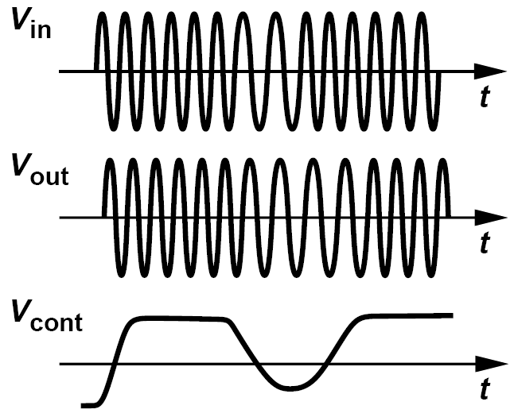
PLL No Better than a Wire?
Having carefully followed our studies thus far, a student reasons that, except for the FSK demodulator application, a PLL is no better than a wire since it attempts to make the input and output frequencies and phases equal! What is the flaw in the student’s argument?
We will better appreciate the role of phase locking later in this chapter. Nonetheless, we can observe that the dynamics of the loop can yield interesting and useful properties. Suppose in the previous example, the input frequency toggles at a relatively high rate, leaving little time for the PLL to “keep up.” As illustrated in figure below, at each input frequency jump, the control voltage begins to change in the opposite direction but does not have enough time to settle. In other words, the output frequency excursions are smaller than the input frequency jumps. The loop thus performs low-pass filtering on the input frequency variations—just as the unity-gain buffer performs low-pass filtering on the input voltage variations if the op amp has a limited bandwidth. In fact, many applications incorporate PLLs to reduce the frequency or phase noise of a signal by means of this low-pass filtering property.

Slide 18
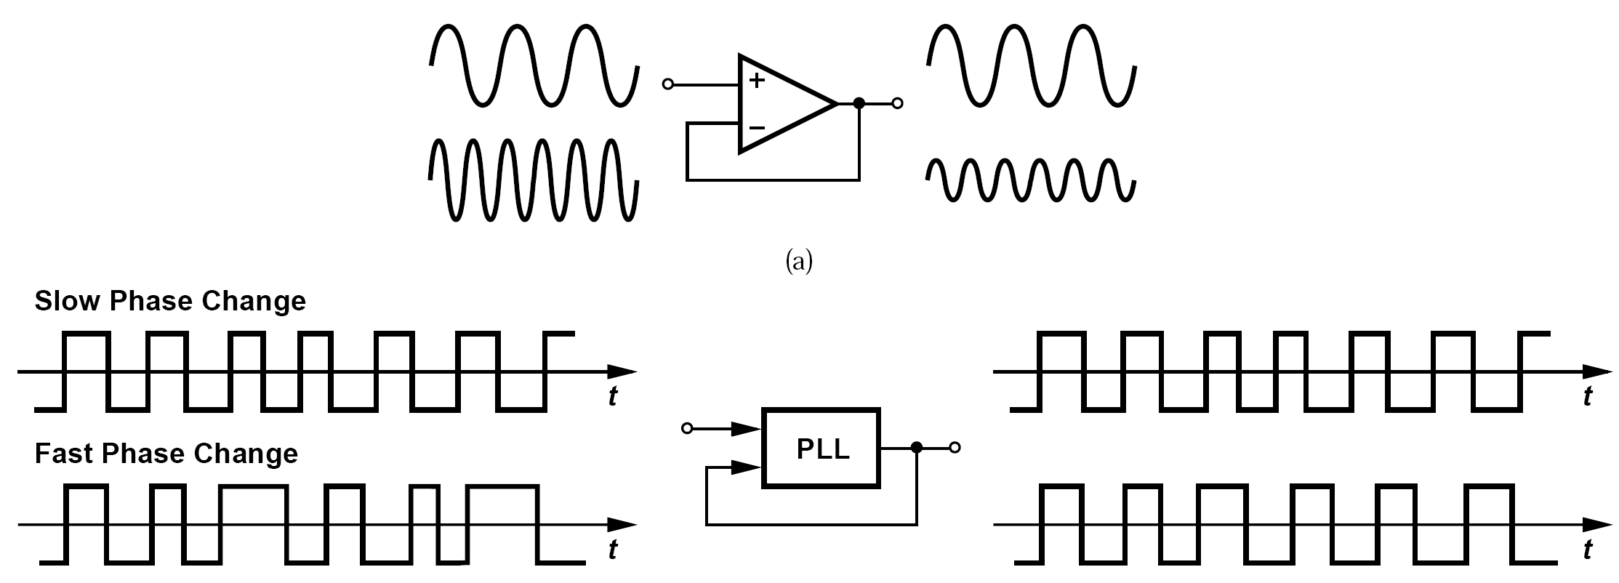
Loop Dynamics: the Meaning of Transfer Function in Phase Domain
The transfer function of a voltage-domain circuit signifies how a sinusoidal input voltage propagates to the output.
The transfer function of a PLL must reveal how a slow or a fast change in the input (excess) phase propagates to the output.

Slide 19
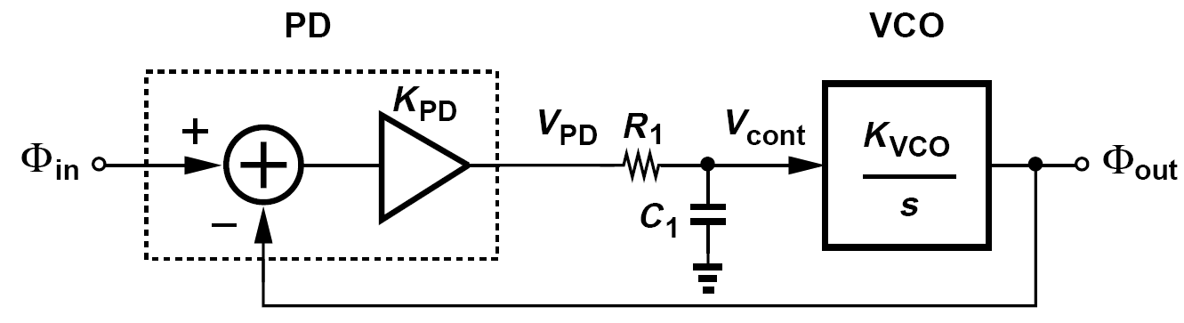

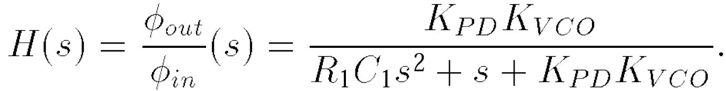
Loop Dynamics: Phase Domain Model
The open-loop transfer function
Overall closed-loop transfer function
The analysis illustrated in PLL implementation suggests that the loop locks with a finite phase error whereas above equation implies that Φ_{out} = Φ_{in} for very slow phase variations. Are these two observations consistent?
Yes, they are. As with any transfer function, above equation deals with changes in the input and the output rather than with their total values. In other words, it merely indicates that a phase step of ΔΦ at the input eventually appears as a phase change of ΔΦ at the output, but it does not provide the static phase offset.

Slide 20
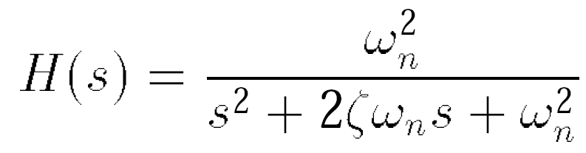
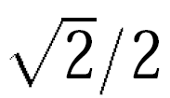
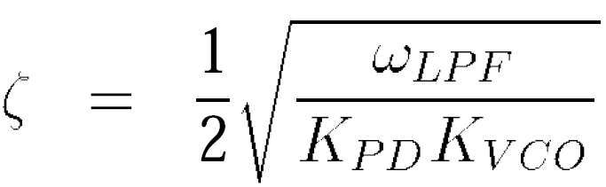
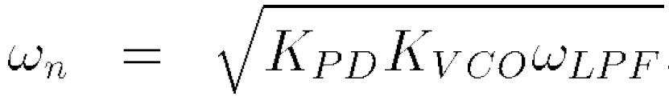
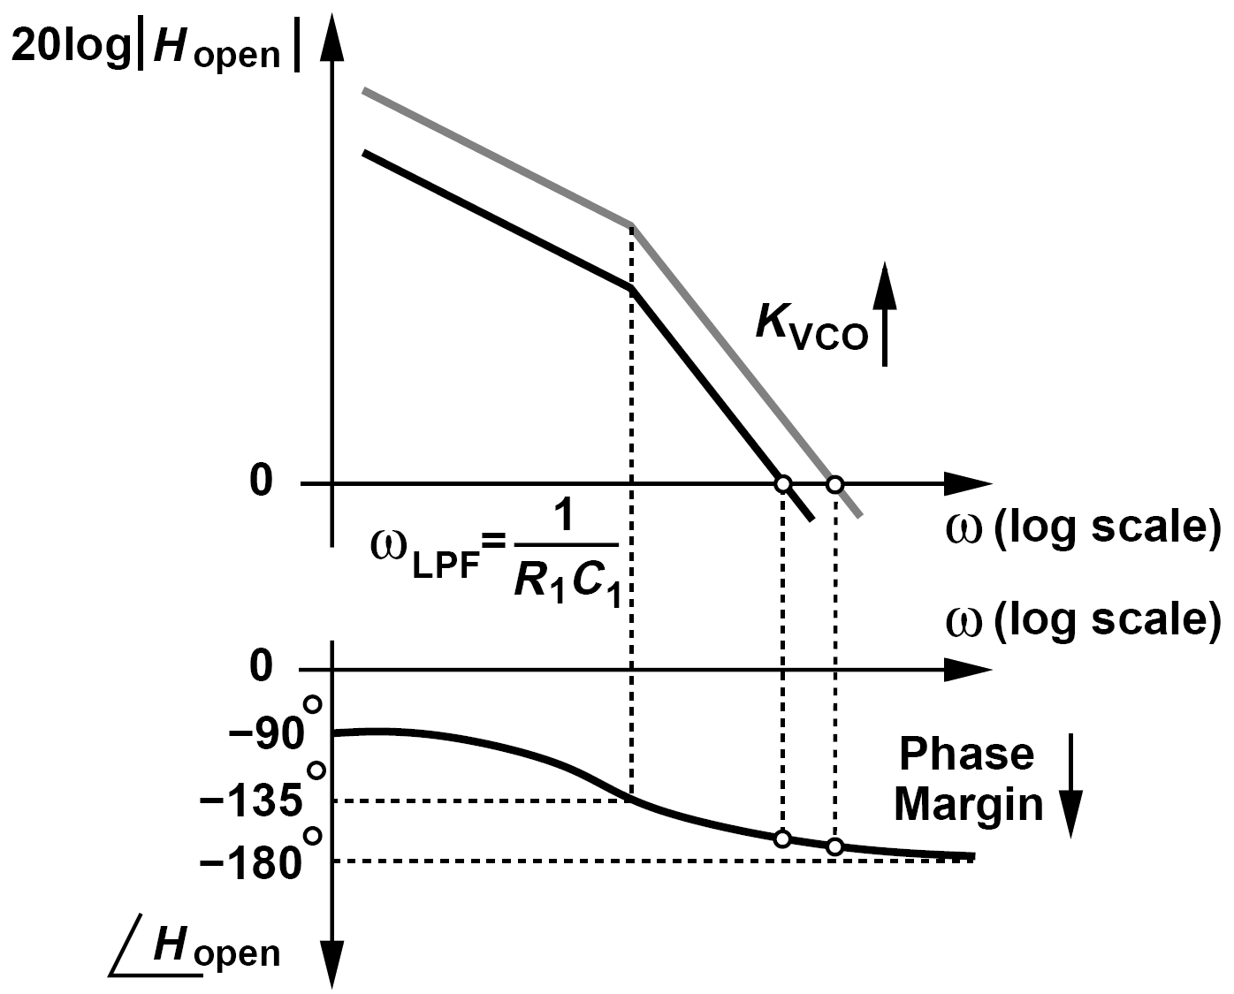
Damping Factor and Natural Frequency
The damping factor is typically chosen to be or larger so as to provide a well-behaved (critical damped or overdamped) response.
ω_{LPF}=1/(R₁C₁)
Using Bode plots of the open-loop system, explain why ζ is inversely proportional to K_{VCO}.
This figure shows the behavior of the open-loop transfer function, H_{open}, for two different values of K_{VCO}. As K_{VCO} increases, the unity-gain frequency rises, thus reducing the phase margin (PM).

Slide 21
Two Additions for Loop Dynamics
Since phase and frequency are related by a linear, time-invariant operation, the equation below also applies to frequency quantities.
How do we ensure the feedback of previous simple PLL implementation is negative?
Solution:
The phase detector provides both negative and positive gains. Thus, the loop automatically locks with negative feedback.

Slide 22
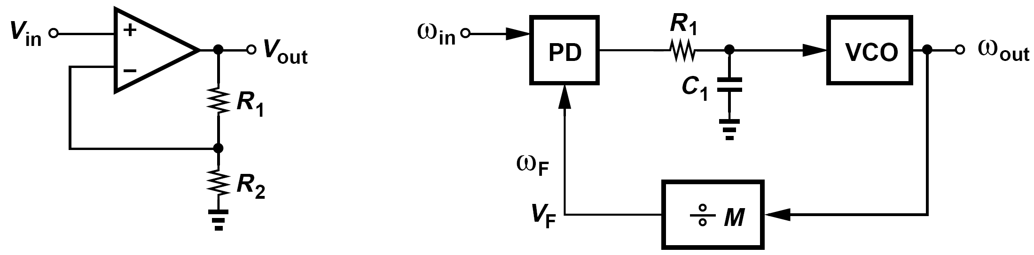
Frequency Multiplication
The output frequency of a PLL can be divided and then fed back.
The ÷M circuit is a counter that generates one output pulse for every M input pulses.
The divide ratio, M, is called the “modulus”.

Slide 23
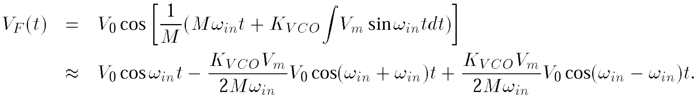
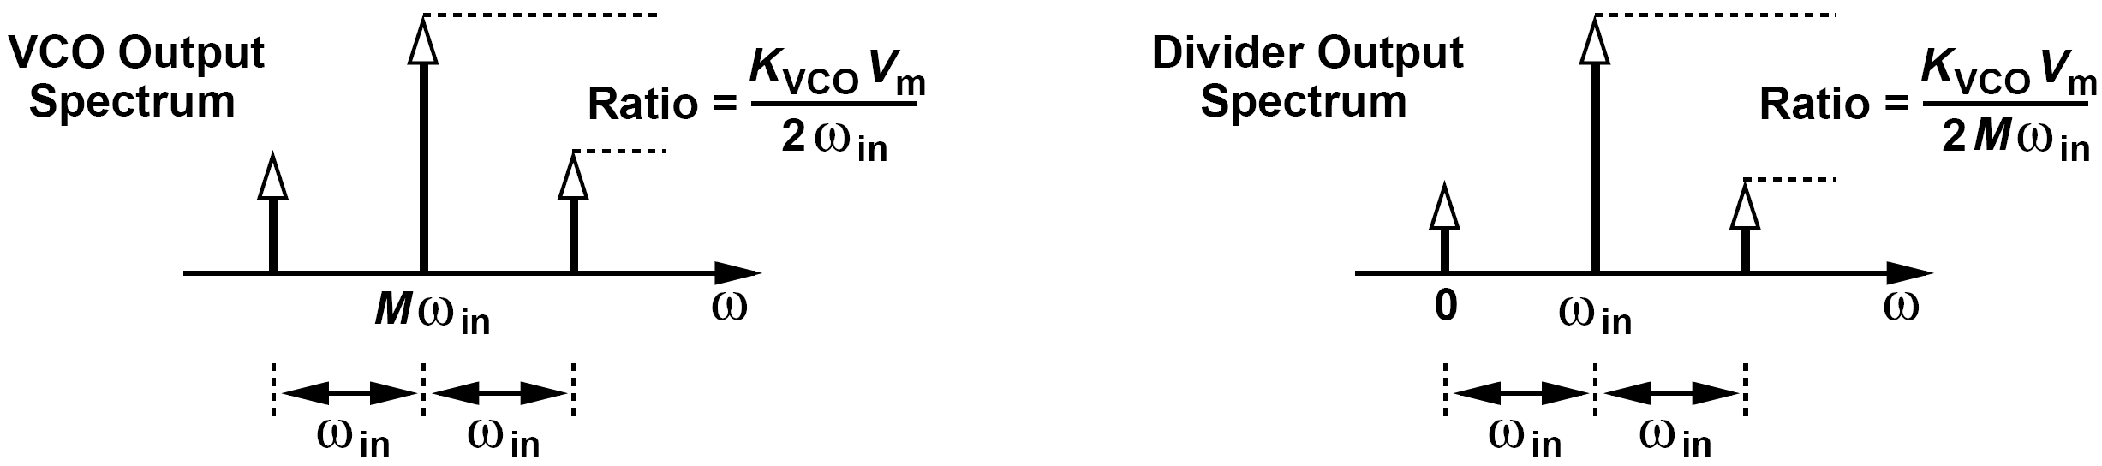
Example of Divider Response to FM Sidebands
The control voltage in figure above experiences a small sinusoidal ripple of amplitude V_{m} at a frequency equal to ω_{in}. Plot the output spectra of the VCO and the divider.
From the narrowband FM approximation, we know that the VCO output contains two sidebands at Mω_{in} ± ω_{in}. How does the divider respond to such a spectrum? Since a frequency divider simply divides the input frequency or phase, we can write V_{F} as
That is, the sidebands maintain their spacing with respect to the carrier after frequency division, but their relative magnitude falls by a factor of M.

Slide 24
Feedback Divider and Loop Dynamics
In analogy with the op amp, we surmise that the weaker feedback leads to a slower response and a larger phase error.
Repeat analysis for PLL in the frequency multiplication depicted above and calculate the static phase error.
Solution:
If ω_{in} changes by Δω, ω_{out} must change by MΔω. Such a change translates to a control voltage change equal to MΔω/K_{VCO} and hence a phase error change of MΔω/(K_{VCO}K_{PD}) As expected, the error is larger by a factor of M.

Slide 25
Drawbacks of Simple PLL
First, a tight relation between the loop stability and the corner frequency of the low-pass filter. Ripple on the control line modulates the VCO frequency and must be suppressed by choosing a low value for ω_{LPF}, leading to a less stable loop
Second, the simple PLL suffers from a limited “acquisition range”. If the VCO frequency and the input frequency are very different at the start-up, the loop may never “acquire” lock.
In addition, the finite static phase error and its variation with the input frequency also prove undesirable in some applications.

Slide 26
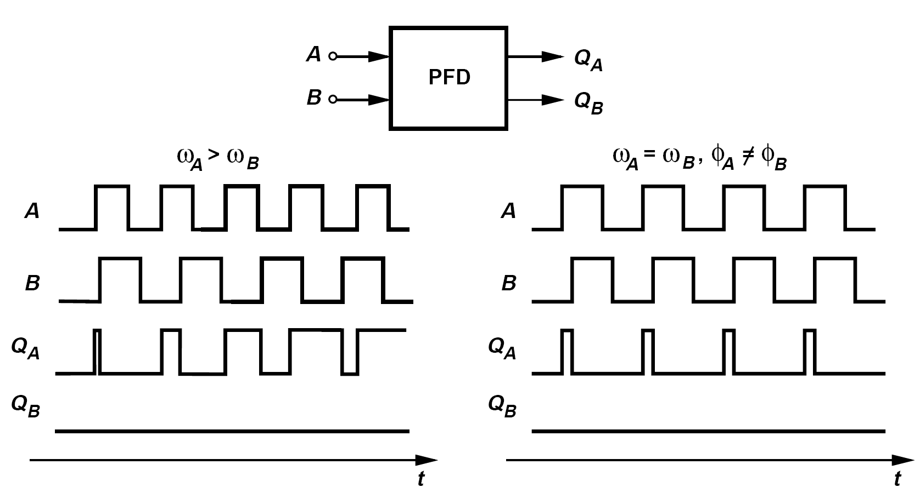
Type-II PLLs: Phase/Frequency Detectors
A rising edge on A yields a rising edge on Q_{A} (if Q_{A} is low)
A rising edge on B resets Q_{A} (if Q_{A} is high)
The circuit is symmetric with respect to A and B (and Q_{A} and Q_{B})

Slide 27
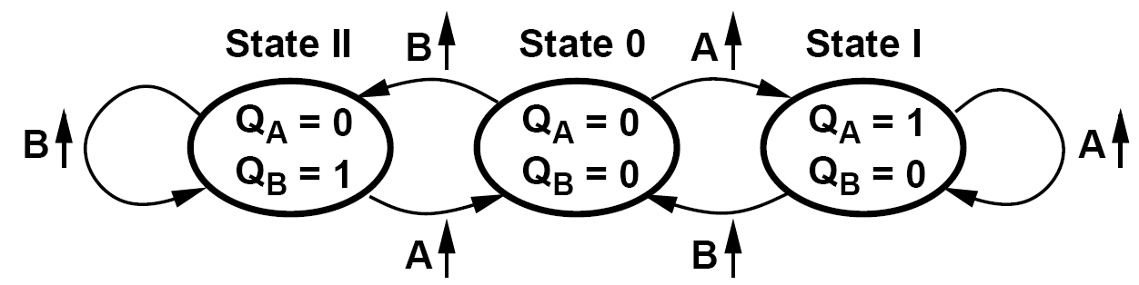
Operation of PFD: State Diagram
At least three logical states are necessary: Q_{A}=Q_{B}=0; Q_{A}=0, Q_{B}=1; and Q_{A}=1, Q_{B}=0
To avoid dependence of the output upon the duty cycle of the inputs, the circuit should be realized as an edge-triggered sequential machine

Slide 28
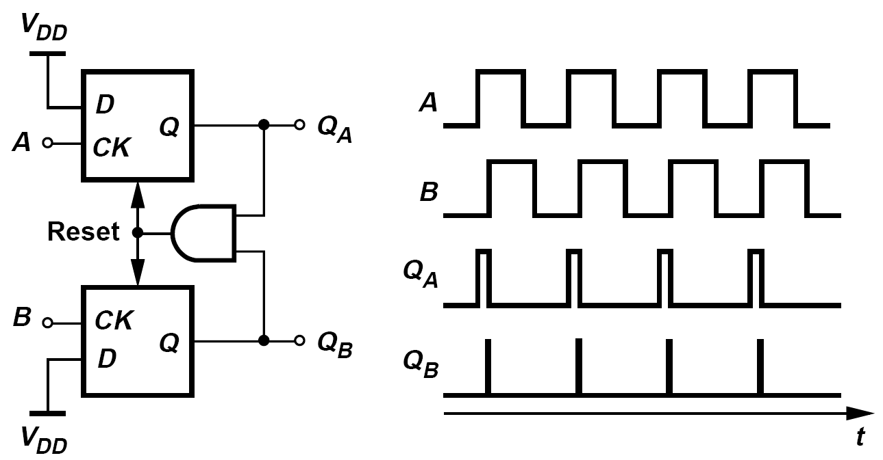
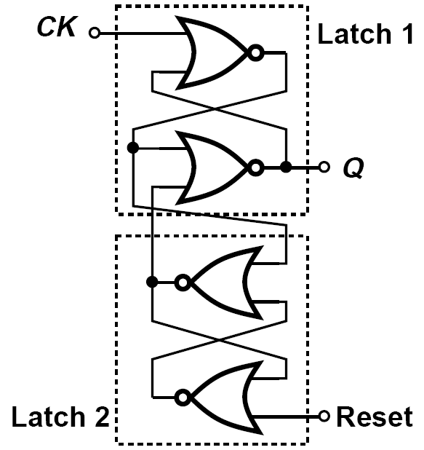
PFD: Logical Implementation
Q_{A} and Q_{B} are simultaneously high for a duration given by the total delay through the AND gate and the reset path of the flipflops.
The width of the narrow reset pulses on Q_{A} and Q_{B} is equal to three gate delays plus the delay of the AND gate

Slide 29
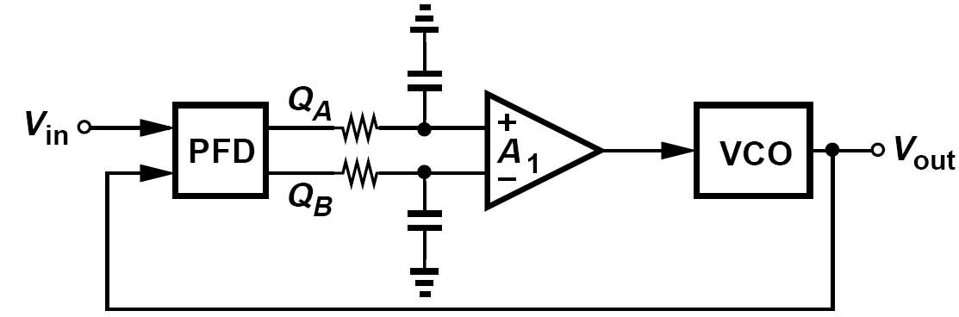
Use of a PFD in PLL
Use of a PFD in a phase-locked loop resolves the issue of the limited acquisition range.
At the beginning of a transient, the PFD acts as a frequency detector, pushing the VCO frequency toward the input frequency. After the two are sufficiently close, the PFD operates as a phase detector, bringing the loop into phase lock.

Slide 30
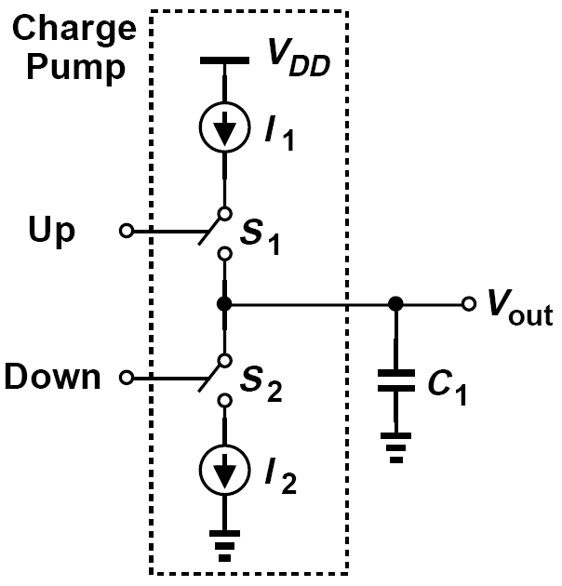
Charge Pumps: an Overview
Switches S₁ and S₂ are controlled by the inputs “UP” and “Down”, respectively.
A pulse of width ΔT on Up turns S₁ on for ΔT seconds, allowing I₁ to charge C₁. V_{out} goes up by ΔT · I₁/C₁
Similarly, a pulse on Down yields a drop in V_{out}.
If Up and Down are asserted simultaneously, I₁ simply flows through S₁ and S₂ to I₂, creating no change in V_{out}.

Slide 31
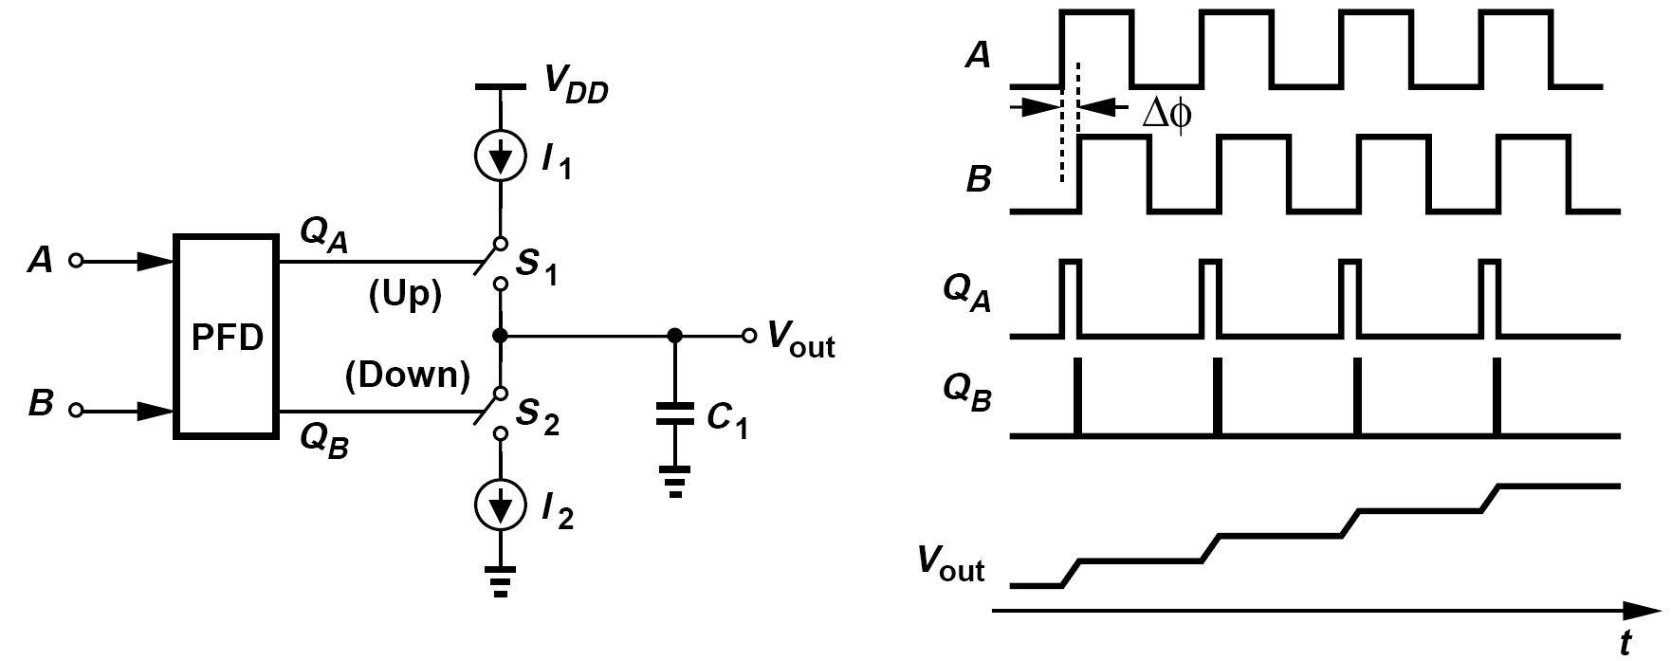
Operation of PFD/CP Cascade
Infinite Gain: An arbitrarily small (constant) phase difference between A and B still turns one switch on, thereby charging or discharging C₁ and driving V_{out} toward +∞ or -∞
We can approximate the PFD/CP circuit of figure above as a current source of some average value driving C₁. Calculate the average value of the current source and the output slope for an input period of T_{in}.
For an input phase difference of ΔΦ rad = [ΔΦ /(2π)] × T_{in} seconds, the average current is equal to I_{p} ΔΦ /(2π) and the average slope, I_{p} ΔΦ /(2π) /C₁.

Slide 32
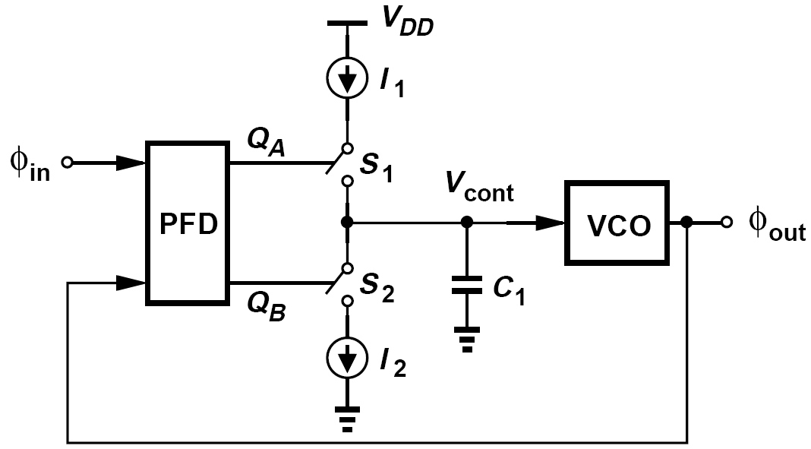
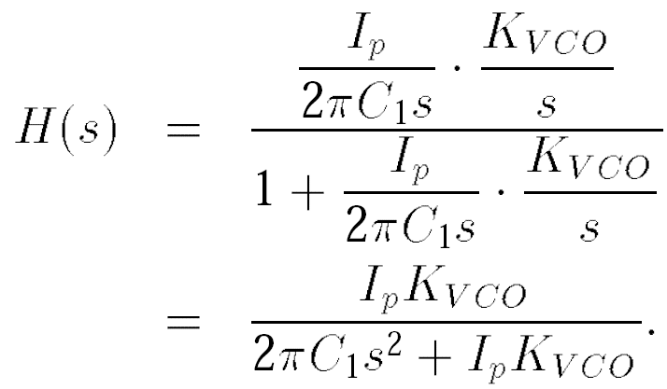
Charge Pump PLLs: First Attempt
Such a loop ideally forces the input phase error to zero because a finite error would lead to an unbounded value fro V_{cont}.
We will first derive the transfer function of the PFD/CP/C₁ cascade.
Called Type-II PLL because its open-loop transfer function contains two poles at the origin

Slide 33
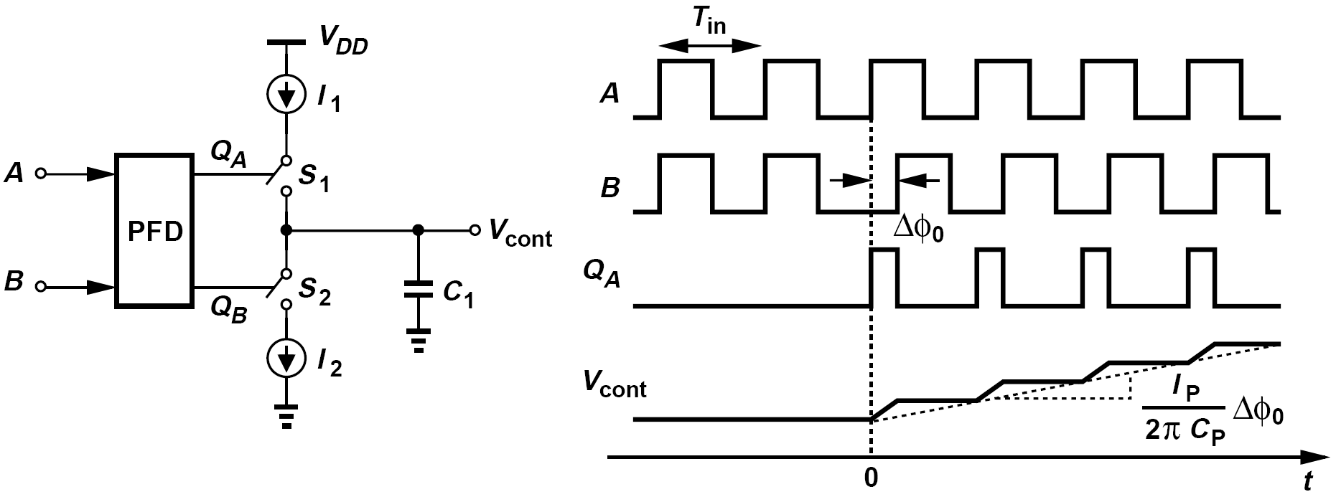
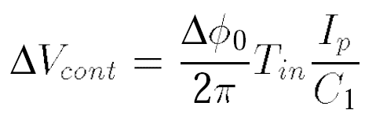
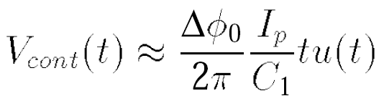
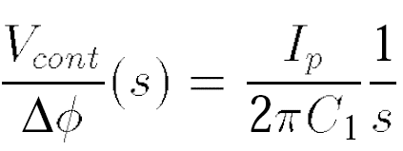
Computation of Transfer Function: Continuous-Time Approximation
We can approximate this waveform by a ramp --- as if the charge pump continuously injected current into C₁
Taking the Laplace transform

Slide 34
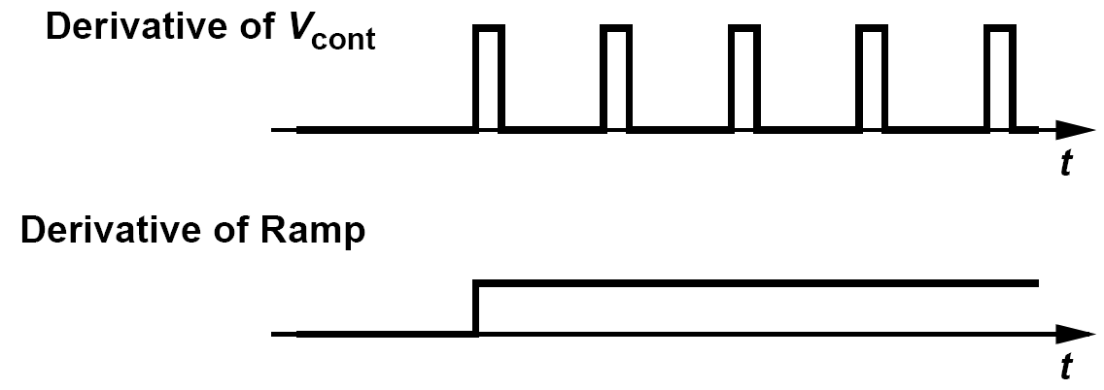
Example: Derivatives of V_{cont} and its Approximation
Plot the derivatives of V_{cont} and its ramp approximation in figure above and explain under what condition the derivatives resemble each other.
Solution:
Shown above are the derivatives. The approximation of repetitive pulses by a single step appears less convincing than the approximation of the charge-and-hold waveform by a ramp. Indeed, if a function f(x) can approximate another function g(x), the derivative of f(x) does not necessarily provide a good approximation of the derivative of g(x). Nonetheless, if the time scale of interest is much longer than the input period, we can view the step as an average of the repetitive pulses. Thus, the height of the step is equal to (I_{p}/C₁)(ΔΦ₀/2π).

Slide 35
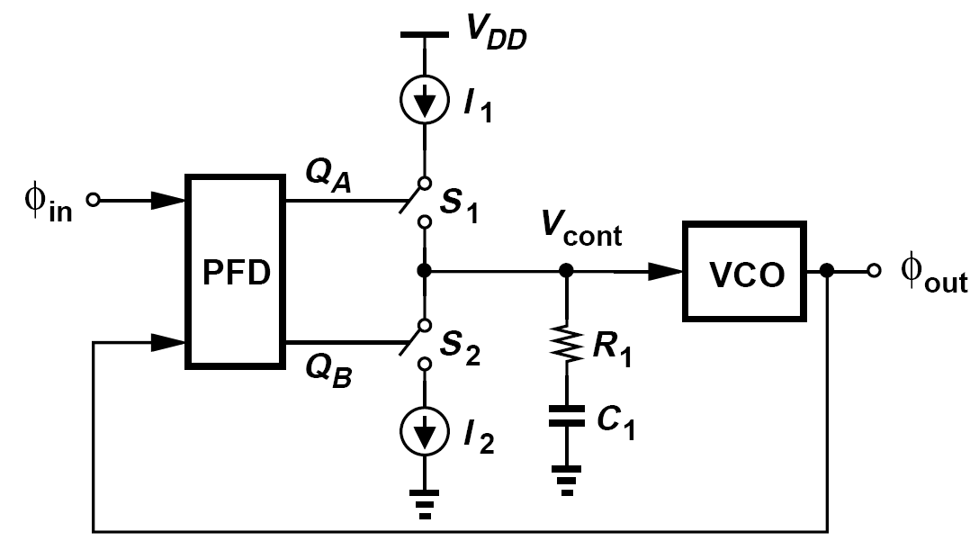
Charge-Pump PLL
If one of the integrators becomes lossy, the system can be stabilized.
This can be accomplished by inserting a resistor in series with C₁. The resulting circuit is called a “charge pump PLL” (CPPLL)

Slide 36
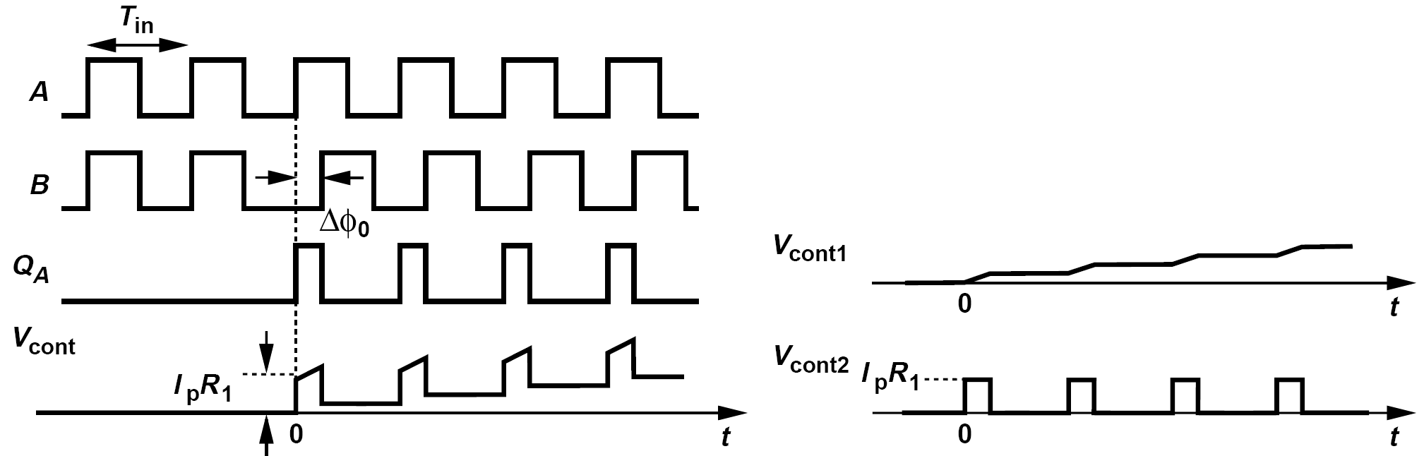
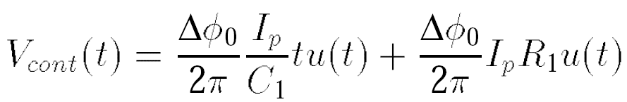
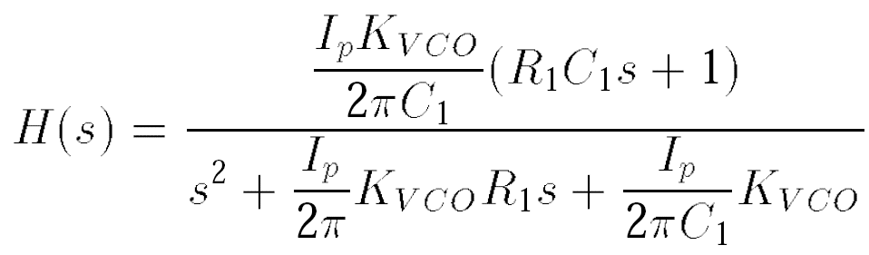
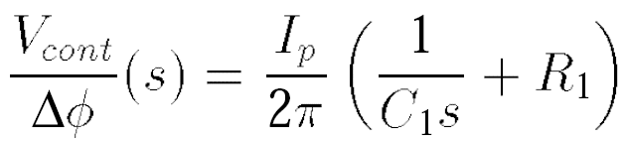
Computation of the Transfer Function
Approximate the pulse sequence by a step of height (I_{p}R₁)[ΔΦ₀/(2π)]:

Slide 37
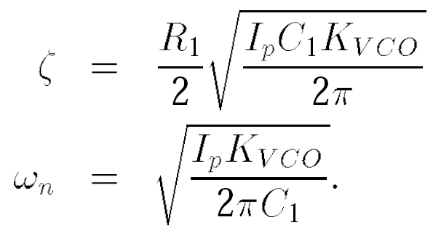
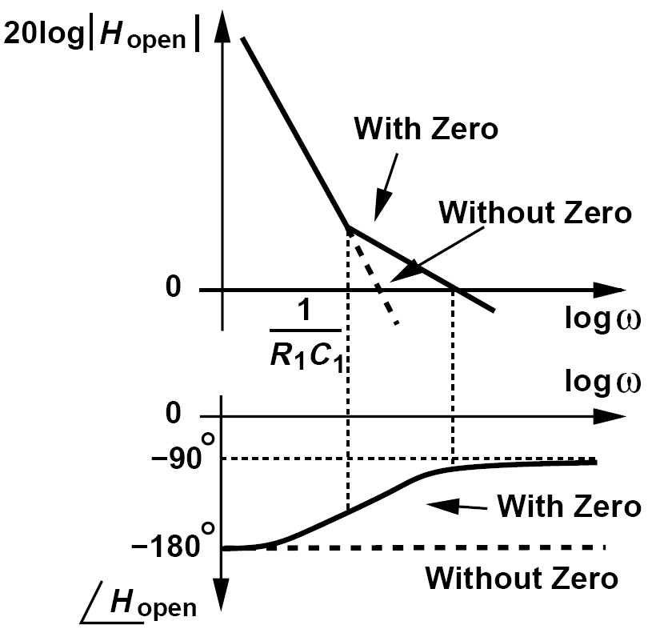


Stability of Charge-Pump PLL
Write the denominator as s2 + 2ζω_{n}s + ω_{n}2
As C₁ increases, so does ζ --- a trend opposite of that observed in type-I PLL: trade-off between stability and ripple amplitude thus removed.
Closed-loop poles are given by
a closed-loop zero at –ω_{n} / 2ζ

Slide 38


Transient Response: An Example to Start
Plot the magnitude of the closed-loop transfer function as a function of ω if ζ = 1
Solution:
The closed loop contains two real coincident poles at -ω_{n} and a zero at -ω_{n}/2. Depicted below |H| begins to rise from unity at ω = ω_{n}/2, reaches a peak at ω = ω_{n}, returns to unity at ω = ω_{n}, and continues to fall at a slope of -20 dB/dec thereafter.

Slide 39

Transient Response: Derivation
From inverse Laplace transform, the output frequency, Δω_{out}, as a function of time for a frequency step at the input, Δω_{in}

Slide 40








Time Constant
Assume:
The time constant of the loop is expressed as
The zero is also located at –ω_{n} / (2ζ)
Approaches a one-pole system having a time constant of 1/ (2ζω_{n})

Slide 41

Example about Time Constant
A student has encountered an inconsistency in our derivations. We concluded above that the loop time constant is approximately equal to 1/ (2ζω_{n}) for ζ2 >> 1, but previous equations evidently imply a time constant of 1/ (ζω_{n}) . Explain the cause of this inconsistency.
Solution:
For ζ2 >> 1, we have ≈ 1. Since cosh x - sinh x = e-x, we have
Thus, the time constant of the loop is indeed equal to 1/ (2ζω_{n}). More generally, we say that with typical values of ζ, the loop time constant lies between 1/ (ζω_{n}) and 1/ (2ζω_{n}).

Slide 42

Limitations of Continuous-Time Approximation
We have made two continuous-time approximations: the charge-and-hold waveform is represented by a ramp, and the series of pulse is modeled by a step.
Illustrated by the graph above, the approximation holds well if the CT waveform changes little from one clock cycle to the next, but loses its accuracy if the CT waveform experiences fast changes.
CPPLL obey the transfer function derived before only if their internal states do not change rapidly from one input cycle to the next.

Slide 43



Frequency-Multiplying CPPLL
As can be seen in the bode plot, the division of K_{VCO} by M makes the loop less stable, requiring that I_{p} and/or C₁ be larger. We can rewrite equation above as

Slide 44




Example of Multiplying PLL with FM Input
The input to a multiplying PLL is a sinusoid with two small “close-in” FM sidebands, i.e., the modulation frequency is relatively low. Determine the output spectrum of the PLL.
The input can be expressed as:
Since the sidebands are small, the narrowband FM approximation applies and the magnitude of the input sidebands normalized to the carrier amplitude is equal to a/(2ω_{m}). Since sinω_{m}t modulates the phase of the input slowly, we let s → 0:

Slide 45

Higher-Order Loops: Drawback of Previous Loop Filter
The loop filter consisting of R₁ and C₁ proves inadequate because, even in the locked condition, it does not suppress the ripple sufficiently.
The ripple consists of positive ad negative pulses of amplitude I_{p}R₁ occurring every T_{in} seconds.

Slide 46



Addition of Second Capacitor to Loop Filter
A common approach to lowering the ripple is to tie a capacitor directly from the control line to ground.
We therefore choose ζ = 0.8 -1 and C₂ ≈ 0.2C₁ in typical designs.
An upper bound derived for R₁ in Appendix I is as:

Slide 47

Example of Topology to Reject Supply Noise
Consider the two filter/VCO topologies shown in figure below and explain which one is preferable with respect to supply noise.
Solution:
In figure top left, the loop filter is “referenced” to ground whereas the voltage across the varactors is referenced to V_{DD}. Since C₁ and C₂ are much greater than the capacitance of the varactors, V_{cont} remains relatively constant and noise on V_{DD} modulates the value of the varactors. On top right, on the other hand, the loop filter and the varactors are referenced to the same “plane,” namely, V_{DD}. Thus, noise on V_{DD} negligibly modulates the voltage across the varactors. In essence, the loop filter “bootstraps” V_{cont} to V_{DD}, allowing the former to track the latter. This topology is therefore preferable. This principle should be observed for the interface between the loop filter and the VCO in any PLL design.

Slide 48


Alternative Second-Order Loop Filter
The ripple at node X may be large but it is suppressed as it travels through the low-pass filter consisting of R₂ and C₂
(R₂C₂)-1 must remain 5 to 10 times higher than ω_{z} so as to yield a reasonable phase margin.

Slide 49

PFD/CP Nonidealities: Up and Down Skew and Width Mismatch
The width of the pulse is equal to the width of the reset pulses, T_{res} (about 5 gate delays), plus ΔT.
The height of the pulse is equal to ΔT I_{p}/C₂

Slide 50


Example of Up and Down Skew and Width Mismatch
Approximating the pulses on the control line by impulses, determine the magnitude of the resulting sidebands at the output of the VCO.
The area under each pulse is approximately given by (ΔTI_{p}/C₂)T_{res} if T_{res} >> 2ΔT. The Fourier transform of the sequence therefore contains impulses at the multiples of the input frequency, f_{in} = 1/T_{in}, with an amplitude of (ΔTI_{p}/C₂)T_{res} /T_{in} . The two impulses at ± 1/T_{in} correspond to a sinusoid having a peak amplitude of 2ΔTI_{p}C₂T_{res} /T_{in} If the narrowband FM approximation holds, we conclude that the relative magnitude of the sidebands at f_{c} ± f_{in} at the VCO output is given by
Sidebands at f_{c} ± n f_{in} are scaled down by a factor of n.

Slide 51

Systematic Skew
The delay of the inverter creates a skew between the Up and Down pulses.
To alleviate this issue, a transmission gate can be inserted in the Down pulse path so as to replicate the delay of the inverter
The quantity of interest is in fact the skew between the Up and Down current waveforms, or ultimately, the net current injected into the loop filter

Slide 52

Example of Widths Mismatch
What is the effect of mismatch between the widths of the Up and Down pulses?
Illustrated above left for the case of Down narrower than Up, this condition may suggest that a pulse of current is injected into the loop filter at each phase comparison instant. However, such periodic injection would continue to increase (or decrease) V_{cont} with no bound. The PLL thus creates a phase offset as shown in figure top right such that the Down pulse becomes as wide as the Up pulse. Consequently, the net current injected into the filter consists of two pulses of equal and opposite areas. For an original width mismatch of
ΔT, previous equation applies here as well.

Slide 53

Voltage Compliance
It is desirable to design the charge pump so that it produces minimum and maximum voltages as close to the supply rails as possible.
Each current source requires a minimum drain-source voltage and each switch sustains a voltage drop.
The output compliance is equal to V_{DD} minus two overdrive voltages and two switch drops

Slide 54





Charge Injection and Clock Feedthrough
As switches turn on, they absorb this charge and as they turn off, they dispel this charge, through source and drain terminals.
the Up and Down pulses couple through C_{GD1} and
C_{GD2.} Initially
charge sharing between C₂ and C₁ reduces this voltage to:

Slide 55

How to Reduce the Effect of Charge Injection and Clock Feedthrough?
Here three ways to reduce the effect of charge injection and clock feedthrough is presented below
source-switched CP use of dummy switches use of differential pairs

Slide 56



Random Mismatch Between Up and Down Currents
the net current is zero if:
the ripple amplitude is equal to:

Slide 57

Channel Length Modulation
Different output voltages inevitably lead to opposite changes in the drain-source voltages of the current sources, thereby creating a larger mismatch.
The maximum departure of I_{X} from zero, I_{max}, divided by the nominal value of I_{p} quantifies the effect of channel-length modulation.

Slide 58

Example of Channel-Length Modulation
The phase offset of a CPPLL varies with the output frequency. Explain why.
Solution:
At each output frequency and hence at each control voltage, channel-length modulation introduces a certain mismatch between the Up and Down currents. As implied by previous equation, this mismatch is normalized to I_{p} and multiplied by T_{res} to yield the phase offset. The general behavior is sketched in figure below.

Slide 59


Circuit Techniques to Deal with Channel Length Modulation: Regulated Cascodes
The output impedance is raised
Drawback stems from the finite response of the auxiliary amplifiers

Slide 60

Circuit Techniques to Deal with Channel Length Modulation: Use of a Servo Loop
A₀ need not provide a fast response
Performance limited by random mismatches between NMOS current sources and between PMOS current sources. Also the op amp must operate with a nearly rail-to-rail input common-mode range.

Slide 61

Gate Switching
Voltage headroom saved
But exacerbates the problem of Up and Down arrival mismatch. Op amp A₀ must operate with a wide input voltage range.

Slide 62

Another Example that Cancels Both Random and Deterministic Mismatches
The accuracy of the circuit is ultimately limited by the charge injection and clock feedthrough mismatch between M₁ and M₅ and between M₂ and M₆

Slide 63

Example of Reference Frequency and Divide Ratio on Sidebands (Ⅰ)
A PLL having a reference frequency of f_{REF} and a divide ratio of N exhibits reference sidebands at the output that are 60 dB below the carrier. If the reference frequency is doubled and the divide ratio is halved (so that the output frequency is unchanged), what happens to the reference sidebands? Assume the CP nonidealities are constant and the time during which the CP is on remains much shorter than T_{REF} = 1/f_{REF} .
Solution:
Figure on the right plots the time-domain and frequency-domain behavior of the control voltage in the first case. Since ΔT << T_{REF} , we approximate each occurrence of the ripple by an impulse of height V₀ ΔT. The spectrum of the ripple thus comprises impulses of height V₀ ΔT /T_{REF} at harmonics of f_{REF} . The two impulses at ± f_{REF} can be viewed in the time domain as a sinusoid having a peak amplitude of 2V₀ ΔT /T_{REF} , producing output sidebands that are below the carrier by a factor of (1/2)(2V₀ ΔT /T_{REF} )K_{VCO}/(2πf_{REF}) = (V₀ ΔTK_{VCO})/(2π).

Slide 64

Example of Reference Frequency and Divide Ratio on Sidebands (Ⅱ)
Now, consider the second case, shown in figure on the right. The ripple repetition rate is doubled, and so is the height of the impulses in the frequency domain. The magnitude of the output sidebands with respect to the carrier is therefore equal to (1/2)(4V₀ ΔT /T_{REF} )K_{VCO}/(4πf_{REF}) = (V₀ ΔTK_{VCO})/(2π). In other words, the sidebands move away from the carrier but their relative magnitude does not change.

Slide 65




Phase Noise in PLLs: VCO Phase Noise
PLL suppresses slow variations in the phase of the VCO but cannot provide much correction for fast variations

Slide 66

Example of VCO Phase Noise
What happens to the frequency response shown above if ωn is increased by a factor of K while ζ remains constant?
Solution:
We observe that both poles scale up by a factor of K. Since Φ_{out}/Φ_{VCO} ≈ s2/ω_{n}2 for s ≈ 0, the plot is shifted down by a factor of K2 at low values of ω. Depicted below, the response now suppresses the VCO phase noise to a greater extent.

Slide 67


Another Example of VCO Phase Noise(Ⅰ)
Consider a PLL with a feedback divide ratio of N. Compare the phase noise behavior of this case with that of a dividerless loop. Assume the output frequency is unchanged.
Redrawing the loop above as shown below on the left, we recognize that the feedback is now weaker by a factor of N. The transfer function still applies, but both ζ and ω_{n} are reduced by a factor of .
What happens to the magnitude plot? We make two observations. (1) To maintain the same transient behavior, ζ must be constant; e.g., the charge pump current must be scaled up by a factor of N. Thus, the poles given by previous equation simply decrease by factor of . (2)For s → 0, Φ_{out}/Φ_{VCO} ≈ s2/ω_{n}2, which is a factor of N higher than that of the dividerless loop. The magnitude of the transfer function thus appears as depicted below on the right.

Slide 68

Another Example of VCO Phase Noise(Ⅱ)
A time-domain perspective can also explain the rise in the output phase noise. Assuming that the output frequency remains unchanged in the two cases, we note that the dividerless loop makes phase comparisons— and hence phase corrections—N times more often than the loop with a divider does. That is, in the presence of a divider, the VCO can accumulate phase noise for N cycles without receiving any correction. Figure below illustrates the two scenarios.

Slide 69





VCO Phase Noise: White Noise and Flicker Noise
low offset frequencies high offset frequencies

Slide 70

Shaped VCO Noise Summary
The overall PLL output phase noise is equal to the sum of S_{A} and S_{B}
The actual shape depends on two factors:
(1) the intersection frequency of α/ω3 and β/ω2
(2) the value of ω_{n}

Slide 71

Example of High and Low Thermal-Noise-Induced Phase Noise
Sketch the overall output phase noise if (a) the intersection of α/ω3 and β/ω2 lies at a low frequency and ω_{n} is quite larger than that, (b) the intersection of α/ω3 and β/ω2 lies at a high frequency and ω_{n} is quite smaller than that. (These two cases represent high and low thermal-noise-induced phase noise, respectively.)
Depicted in figure below (left), the first case contains little 1/f noise contribution, exhibiting a shaped phase noise, S_{out}, that merely follows β/ω2 at large offsets. The second case, shown in figure below (right), is dominated by the shaped 1/f noise regime and provides a shaped spectrum nearly equal to the free-running VCO phase noise beyond roughly ω = ω_{n}. We observe that the PLL phase noise experiences more peaking in the latter case.

Slide 72


Reference Phase Noise: the Overall Behavior
Crystal oscillators providing the reference typically display a flat phase noise profile beyond an offset of a few kilohertz

Slide 73

Reference Phase Noise: Two Observations
PLLs performing frequency multiplication “amplify” the low-frequency reference phase noise proportionally.
The total phase noise at the output increases with the loop bandwidth

Slide 74





Loop Bandwidth

Slide 75


Design Procedure
The design of PLLs begins with the building blocks: the VCO is designed according to the criteria and the procedure described in Chapter 8; the feedback divider is designed to provide the required divide ratio and operate at the maximum VCO frequency (Chapter 10); the PFD is designed with careful attention to the matching of the Up and Down pulses; and the charge pump is designed for a wide output voltage range, minimal channel-length modulation, etc. In the next step, a loop filter must be chosen and the building blocks must be assembled so as to form the PLL.
We begin with two governing equations:
and choose:
Since K_{VCO} is known from the design of the VCO, we now have two equations and three unknowns.

Slide 76
Example of Design Procedure of PLL
A PLL must generate an output frequency of 2.4 GHz from a 1-MHz reference. If K_{VCO} = 300 MHz/V, determine the other loop parameters.
Solution:
We select ζ = 1, 2.5ω_{n} = ω_{in}/10, i.e., ω_{n} = 2π(40 kHz), and I_{p} = 500 μA. Substituting K_{VCO} =
2π ×(300MHz/V) yields C₁ = 0:99 nF. This large value necessitates an off-chip capacitor. Next, previous equation gives R₁ = 8:04 kΩ. Also, C₂ = 0.2 nF. As explained in Appendix I, the choice of ζ = 1 and C₂ = 0.2C₁ automatically guarantees the condition.
Since C₁ is quite large, we can revise our choice of I_{p}. For example, if I_{p} = 100 μA, then C₁ = 0.2 nF (still quite large). But, for ζ = 1, R₁ must be raised by a factor of 5, i.e., R₁ = 40.2 kΩ. Also, C₂ = 40 pF.

Slide 77





Appendix I: Phase Margin of Type-II PLLs--- Second Order
Let us first calculate the value of ω_{u}
We have
The phase margin is therefore given by:

Slide 78

Example of Phase Margin of Type-II PLLs--- Second Order
Sketch the open-loop characteristics of the PLL with R₁ or C₁ as a variable
The two trends depicted in figure above shed light on the stronger dependence of ζ on R₁ than on C₁: in the former, the PM increases because ω_{z} falls and ω_{u} rises whereas in the latter, the PM increases only because ω_{z} falls.

Slide 79







Appendix I: Phase Margin of Type-II PLLs--- Third Order
where
and hence

Slide 80




An Important Limitation in Choice of Loop Parameters
With C₂ present, R₁ cannot be arbitrarily large
hence

Slide 81

References (Ⅰ)

Slide 82

References (Ⅱ)

